Slide 1

BHARATRATNA DR. BABASAHEB AMBEDKAR LAW COLLEGE
SUBJECT ENVIRONMENTAL LAW
TOPIC: DISASTER MANAGEMENT
NAME: VARSHA ASHOK SINGH
1
ROLL NO. :LLB20351
2
EMAIL ID: varshasingh8860@gmail.com
3
GUIDE BY: PROF. SANTOSH THAKUR SIR
4

Slide 2
INDEX
SERIAL NO. | PARTICILARS | PAGE NO.
1. | Introduction and Definition | 3
2. | Classification and Typea of Disaster Management | 4
3. | Disaster Preparedness | 5
4. | Medical and Public Health Response | 6
5. | Disaster Mitigation | 7
6. | Recent Disaster in India | 8
7. | Conclusion | 9

Slide 3
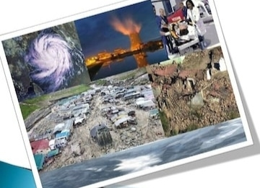
INTRODUCTION AND DEFINITION
Disaster management is sweeping through major cities all over the world disaster preparedness or management is the need of the hour. Disaster are either natural, such as flood, droughts, cyclone and earthquakes, or man-made such as riots, conflict, refugee, situation and other like fire, epidemic, industrial accident and environmental fallouts. Often the difference between them is marginal. Mass disaster means a disaster or calamities on a large scale. The disaster in the ecology and environmental is spread over a vast area.The mankind had witnessed in the past sometimes and in recent years, many a times, a series of carastrophes and disasters, both, natural, and man-made have shaken the faith of the people of the world, their capacity to manage their own affairs, especially in the event of a massive disaster. It is a high time that people learn some basic lessons, not only to survive, but to live truly. In fact, some of the natural disaster like flood and earthquakes might be attributed to man’s atrocities against the mother-nature. The victims of mass disaster are very large in number. There is a considerable loss of human life and property when mass disaster occure, it instant attention to avoid mass casualties, storm, building collapse etc.

Slide 4
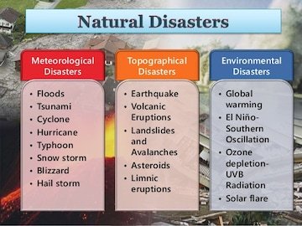
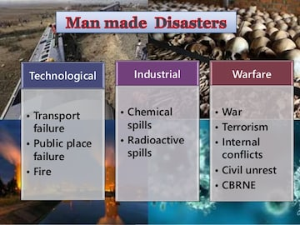
CLASSIFICATION AND TYPES OF DISASTER MANAGEMENT

Slide 5
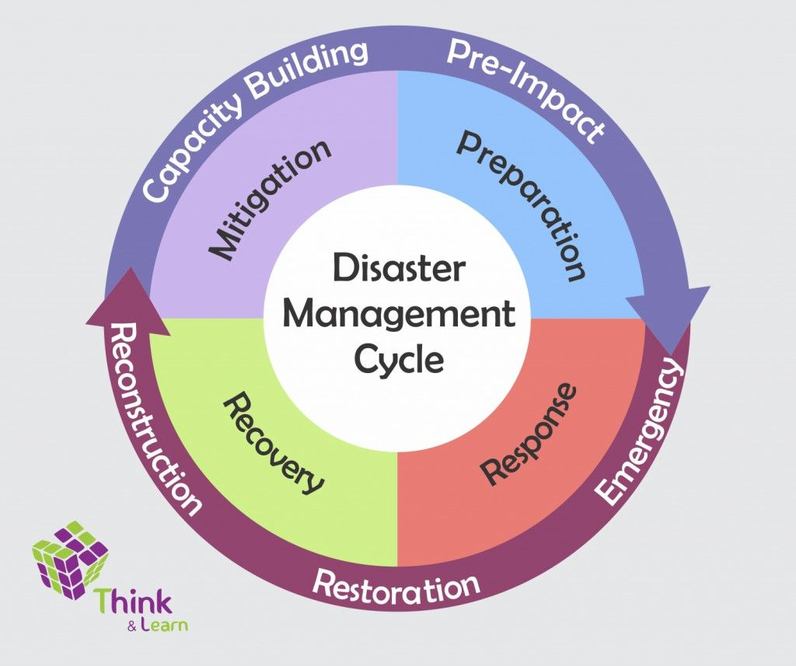
DISASTER PREPAREDNESS
Disaster preparedness is going on multisectorial activity. Integral part of the national system responsible for developing and programmes for disaster management, prevention, mitigation, response, rehabilitation and reconstruction.
Co-ordination of a veriety of sector to carry out
1.Eveluation of the risk.
2.Adopt standards and regulations.
3.Organize communication and response mechanism.
4.Ensure all resources-ready and easily mobilized.
5.Develop public education programmes.
6.Co-ordination information with news media.
7.Disaster stimulation exercises.
8. Prevention of danger ot threat of any disaster
DISASTER MANAGEMENT: A countinuous and intregated process of planning, organizing, coordinating and implementing measures which are necessary or expendient for- Evacuation, rescue and relief, rehabilitation and reconstruction, capacity-building, preparedness to deal with any disaster etc.
DISATER RESPONSE: imidiate reaction to disaster as the disaster is anticipated, or soon after it begins in order to assess the needs, reduce the suffering, limit the spread and consequences of the disaster, open up the way to rehabilitation. By- Mass evacuation, search and rescue, emergency medical services, securing food and water, maintenance of law and order.

Slide 6
Medical and public health RESPONSE
Providing decision makers with the in-depth analysis and recommendations they need to prepare for and respond to public health emergencies and disasters. Below are some recent publications and projects related to disaster preparedness and response.
To provide timely effective assistance to disaster victims to facilitates relief measures and rehabilitation of services. ... Health care workers have unique skills for handling all aspects of disasters. It includes assessment, priority setting, collaboration, and addressing both preventive and acute care needs.
To respond during emergencies or disasters, public health systems need to have seven core system capacities in place: (1) preparedness and response capabilities; (2) communication services; (3) information systems; (4) epidemiology/surveillance; (5) laboratory services; (6) policy and evaluation; and (7) workforce ...these are the basic function of disaster management in medical health.
A public health assessment is formally defined as “The evaluation of data and information on the release of hazardous substances into the environment in order to assess any past, current, or future impact on public health, develop health advisories or other recommendations, and identify studies or actions needed to .

Slide 7
DISASTER MITIGATION
This involves lossning the likely effect of emergencies
These includes depending upon the disaster, protection of vulnerable population and structure
Eg. Improving structure qualities of schools, houses and other buildings so that medical causalities can be minimized.
Similary ensuring the saftey of health facility and public Health service including water supply and sewerage system to reduce the cost of rehabilitation and reconstruction.
This mitigation compliments the disaster preparedness and disaster response activity.
Disaster mitigation measures are those that eliminate or reduce the impacts and risks of hazards through proactive measures taken before an emergency or disaster occurs. One of the best known examples of investment in disaster mitigation is the Red River Floodway.
Awareness, education, preparedness, and prediction and warning systems can reduce the disruptive impacts of a natural disaster on communities. Mitigation measures such as adoption of zoning, land-use practices, and building codes are needed, however, to prevent or reduce actual damage from hazards.
Examples of mitigation actions are planning and zoning, floodplain protection, property acquisition and relocation, or public outreach projects. Examples of preparedness actions are installing disaster warning systems, purchasing radio communications equipment, or conducting emergency response training.

Slide 8
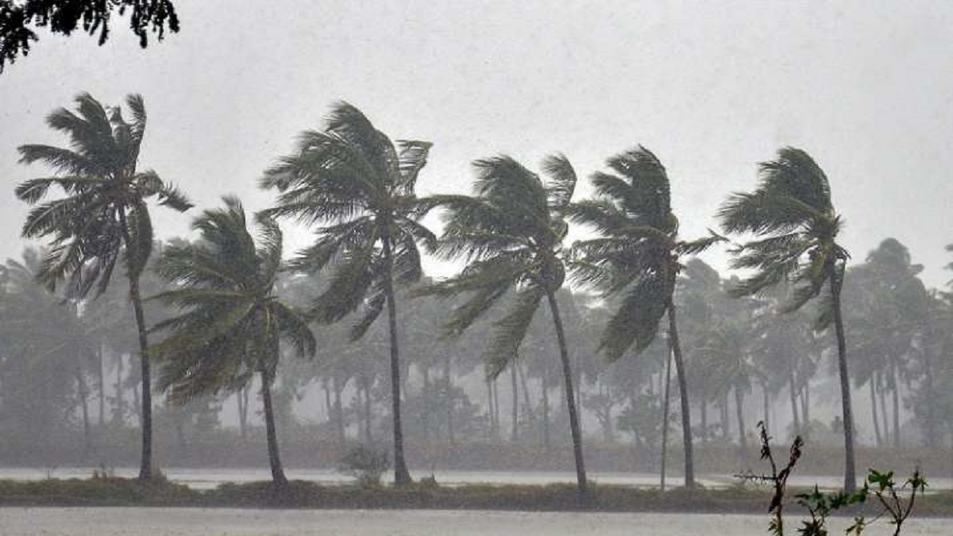
RECENT DISASTER IN INDIA
Cyclone amphan, considered to be the second major cyclone in the Bay of Bengal after the super cyclone of 1999, devastated West Bengal in May 2020. The death toll in West Bengal due to the cyclone stands at 86. The cyclone also left a trail of massive destruction of property in the state before moving to Bangladesh.
Cyclone Nisarg:. In June, Cyclone Nisarga struck the Western coast of the country making landfall in Maharashtra. ...
On 7 February 2021, residents of the Chamoli district in Uttarakhand saw a plume of dust coming down through the valley followed swiftly by a massive amount of water that damaged two hydropower projects.
2019–2021 locust infestation.
2020 Dahej chemical plant explosion.
2020 Uttarakhand forest fires.

Slide 9

Conclusion
The current “nonsystem” for providing information for disaster management is not effectively utilizing a wealth of information that resides with various organizations. Existing technologies could deliver to disaster managers important new information products that could save lives, reduce damage to property, and lessen the environmental impacts of natural disasters. Continued improvements in technology should help make information more widely, quickly, and reliably available—and at less cost. The current situation is characterized by numerous shortcomings that inhibit optimal decision-making for disaster management. The inability to access information and the lack of standardization, coordination, and communication are all obstacles that a disaster information network (DIN) could overcome. It is recommended that the Global Disaster Information Network (GDIN) Transition Team move ahead in planning for a disaster information network, taking into account the following conclusions from the present study:
Always be alert to the disaster news. Some places are routinely experiencing earthquakes and most probably have some regular disasters or disaster like situations such as rainfall, heavy rainfall,snowfall, high sea tides, etc. Such disasters have some seasonal time of occurrence.
Another important point is financial point. Most of the countries have annual budget for disaster management. But these funds are to be utilized during that particular year. The funds expire if not utilized during that financial year . It would be better if respective governments retain the amount and add it to next year financial year. In this manner, the availability of funds would go on increasing.
Second important thing is to carry once or twice a year a mock drill about disaster management.
The last and most important is to observe a national disaster management / mitigation day at various levels.

Slide 10


